Slide 1
Project Presentation
Nordstrom.com

Slide 2
Team Members
Hardika Muni
Nikunj Ratnaparkhi
Shweta Vyas

Slide 3
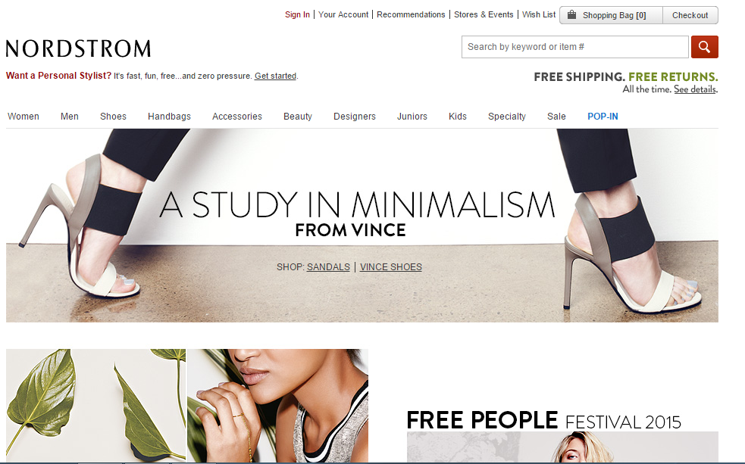
NordStrom.com
It’s an American fashion retailer company since 1901 founded by John W. Nordstrom.

Slide 4
NordStrom.com
The company began as a shoe retailer and has since expanded its inventory to include clothing, accessories, handbags, jewelry, cosmetics, and fragrances.
There are 271 stores operating in 36 states, which includes 117 full-line stores and 151 Nordstrom Racks.
Nordstrom also serves customers through Nordstrom.com, the newly developed e-commerce site nordstromrack.com.

Slide 5
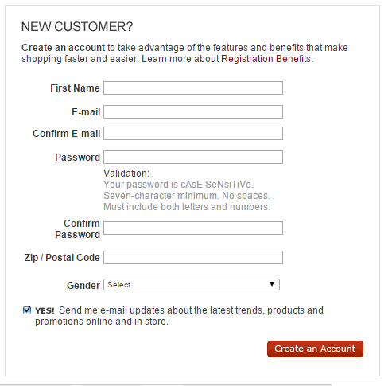
Why Nordstrom

Slide 6
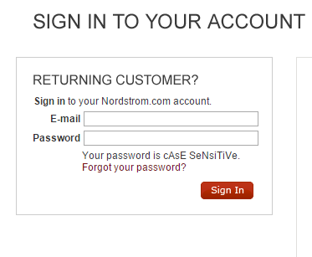
Why Nordstrom

Slide 7
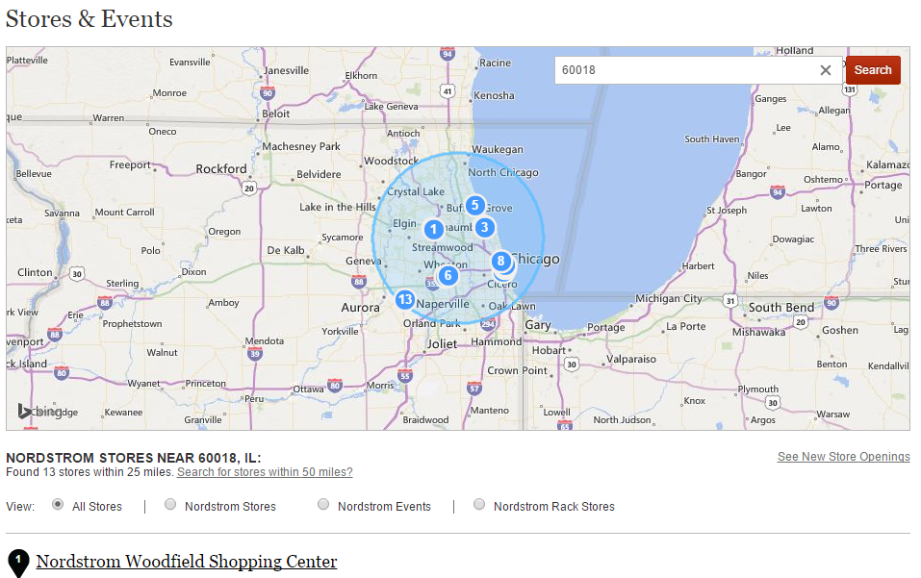
Why Nordstrom

Slide 8
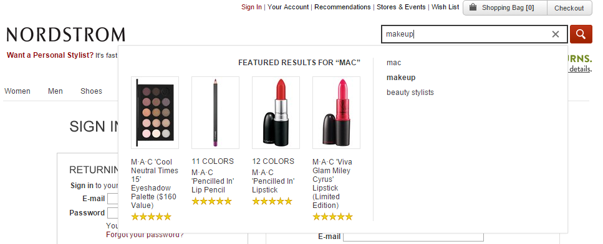
Why Nordstrom

Slide 9
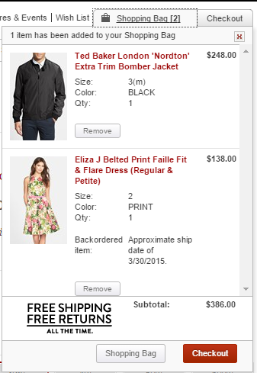
Why Nordstrom

Slide 10
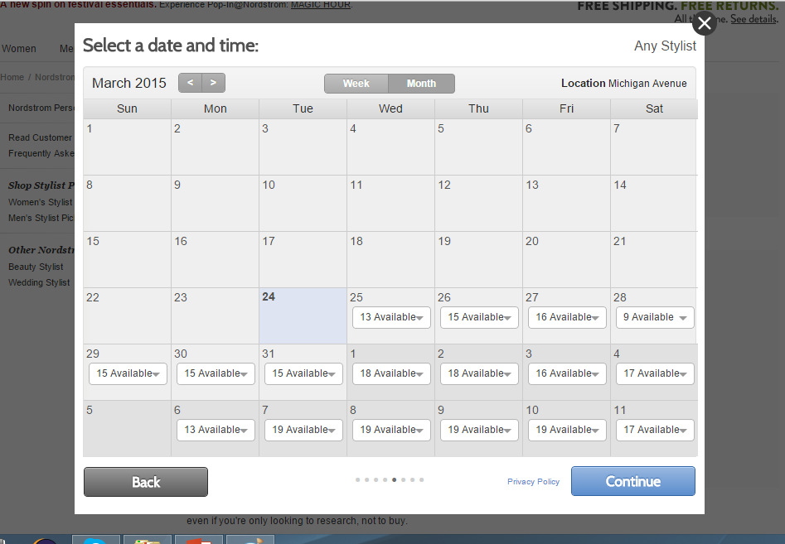
Why Nordstrom

Slide 11
Lessons Learnt
Whenever there is a change of frame and loading takes place in the new frame then it is always good to give a pause.
If there is a ID which changes very frequently then it is best to find unique Xpath by involving multiple html elements.
Test data should be validated for its correctness for the test method it is used for.
Everything can’t be automated.

Slide 12
References
Wikipedia: http://en.wikipedia.org/wiki/Nordstrom
Selenium Web Driver: http://docs.seleniumhq.org/projects/webdriver/
Nordstrom Website: http://shop.nordstrom.com/

Slide 13
Thank You
Hands On!

